Slide 1
Idea Proposal
Team Name: Code-Strykers

Slide 2



Idea Description(Short)
Idea Id: 3322
Theme: COVID-19
Team Name: Code-Strykers
Solution Approach
The user visits a website with the COVID-19 chatbot and asks a question.
The Node.js web server calls Watson Assistant hosted in IBM Cloud and passes on the question
Watson Assistant uses natural language understanding and machine learning to extract entities and intents from the user question.
Watson Assistant invokes an OpenWhisk open source-powered IBM Cloud Function.
IBM Cloud Function calls Watson Discovery running in IBM Cloud which in turn presents an external URL for detailed information about current Covid-19 situation.
IBM Cloud Function also calls a series of COVID-19 APIs to get Country wise / State wise / District wise near-real time statistics about the current pandemic situation (APIs included are - api.covid19api.com, api.covid19india.org, api.rootnet.in)
The COVID-19 FAQ presents commonly asked questions about the pandemic for the user to select from.
When Watson Assistant gets the input from the above steps, it replies to Node.js web server with the detailed information.
There is another option for users to self-assess their current health status by answering a set of questions. Based on the inputs, Watson Assistant determines the probability of the users to get infected from Covid-19 and passes on the information to Node.js.
The Node.js web server displays the information to the user.
Challenge/ Scenario
Current COVID 19 pandemic is continuously raising questions on its symptoms, what are the good habits to avoid getting infected, nearby medical facilities for test and treatment as well as the current status of schools, transportation, and other public services.
But, in times of crisis, most of the call centers or helpline numbers are often overloaded with high volume of incoming calls, thus raising the wait time, quality of service and panic. Any other communication service is either rarely available especially in the urban and rural areas or not with sufficient details.
But, what if people have a chat service available, which will be able to provide response to the different queries frequently asked by the users and guide them in this pandemic.

Slide 3

Idea Description(Short)
Idea Id: 3322
Theme: COVID-19
Team Name: Code-Strykers
Impact / Benefit of the idea
Target Customers/ Industry
Detection of probability of having COVID-19 based on the symptoms received as inputs from user
Caller's Zone Detection – Near real time detection of Containment Zone / Red Zone and other
Providing Information about the Containment Zones nearby Caller's Location, Caller's District and State
Identification of nearby government COVID-19 medical centers / isolation centers.
Publishing near real time worldwide COVID-19 status
Getting all COVID-19 related near real time updates promptly with no cost associated
In-depth understanding of the symptoms the users currently have and determine the probability of getting COVID-19 infected.
Users across India who wants timely information in times of the pandemic

Slide 4
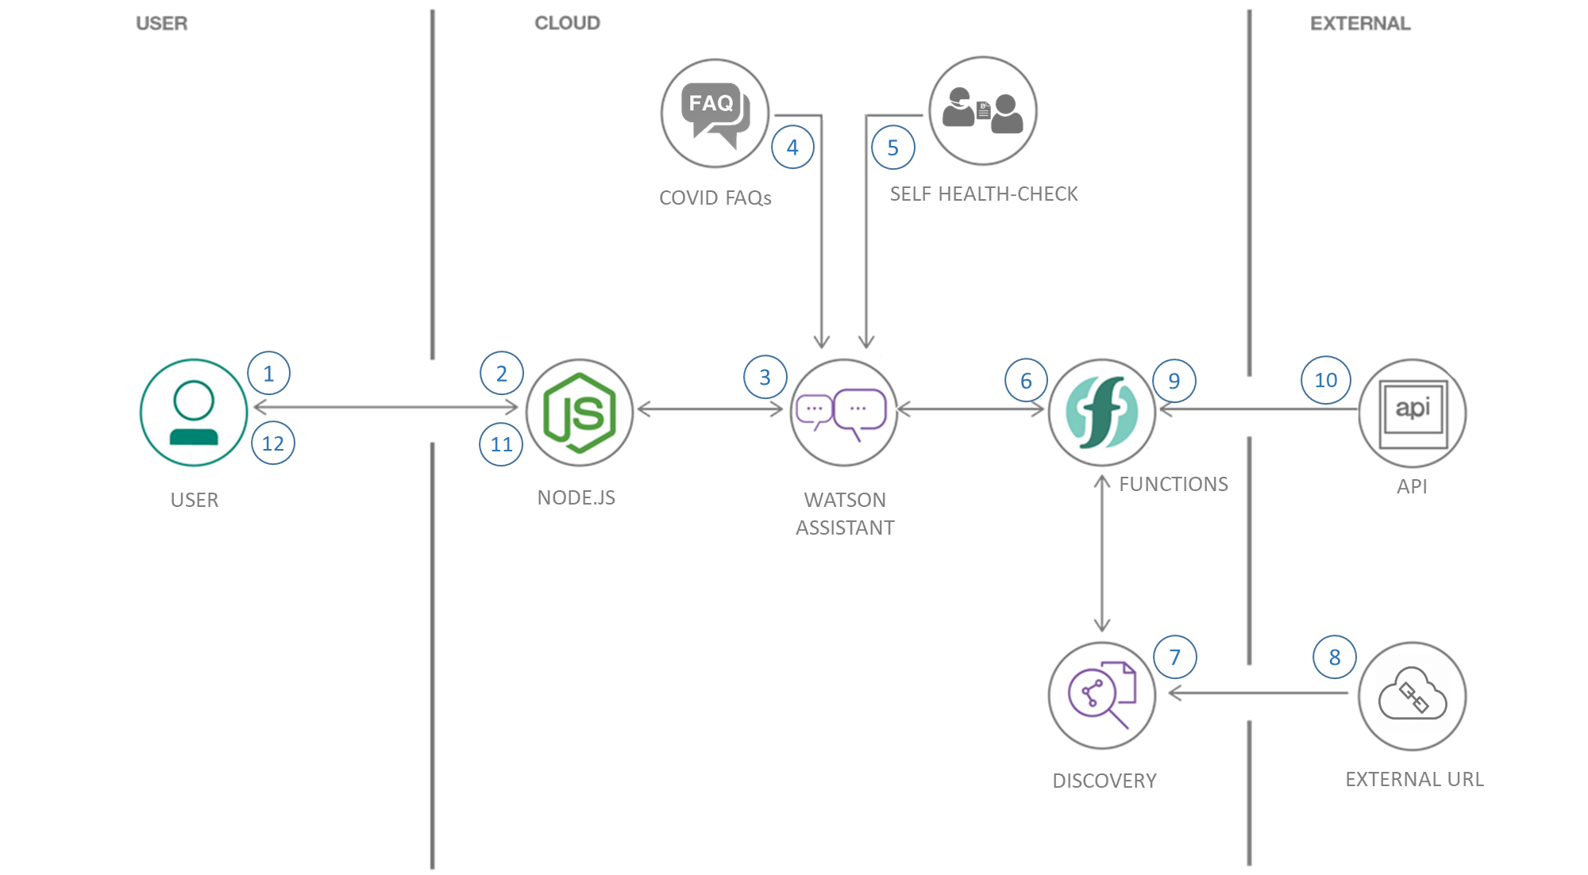
Idea Description(Short)
Architecture Diagram if any can be attached here
Please embed the links for the submission done on IBM Cloud here
https://web-chat.global.assistant.watson.cloud.ibm.com/preview.html?region=eu-gb&integrationID=e222ce6d-7923-4330-abd6-b9a223d12358&serviceInstanceID=fd10a9da-d1f9-4fae-abb7-01a04cc81d83
1. The user visits a website with the COVID-19 chatbot and asks a question.
2. The Node.js web server calls Watson Assistant hosted in IBM Cloud.
3. Watson Assistant uses natural language understanding and machine learning to extract entities and intents of the user question.
4. The COVID-19 FAQ presents commonly asked questions about the pandemic for the user to select
5. There is another option for users to self-assess their current health status by answering a set of questions.
6. Watson Assistant invokes an OpenWhisk open source-powered IBM Cloud Function.
7. IBM Cloud Function calls Watson Discovery running in IBM Cloud.
8. Watson Discovery presents an external URL for detailed information
9. Watson Assistant invokes an OpenWhisk open source powered IBM Cloud Function.
10. IBM Cloud Function calls a series of COVID-19 APIs to get statistics.
11. Watson Assistant replies to the user inquiry.
12. The Node.js web server displays the chat answer to the user.

